Slide 1
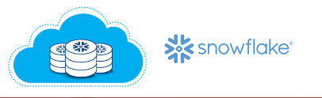

Slide 2
Traditional - ETL / DWH / BI

Slide 3
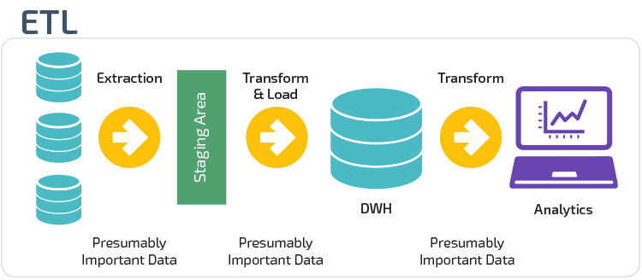


Slide 4
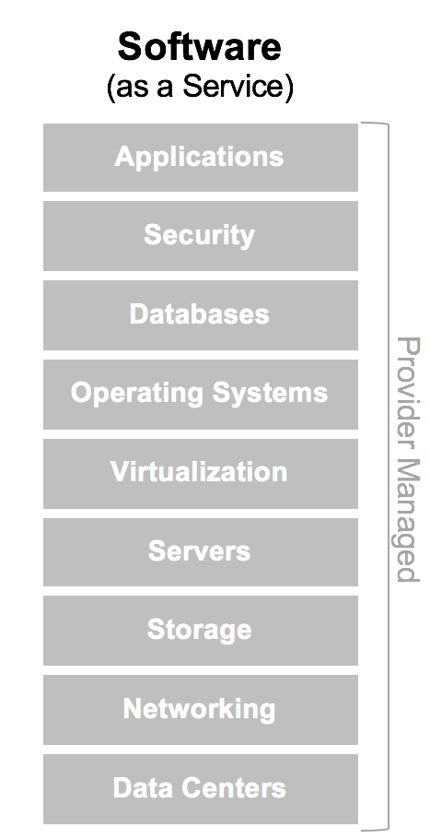
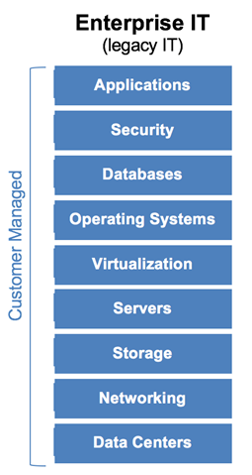
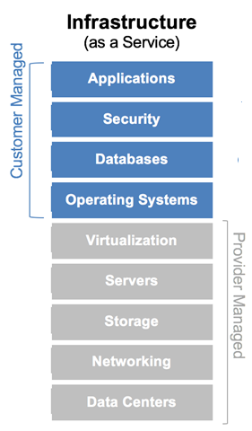
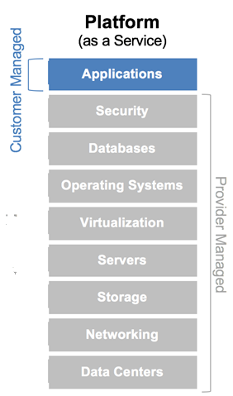


Slide 5
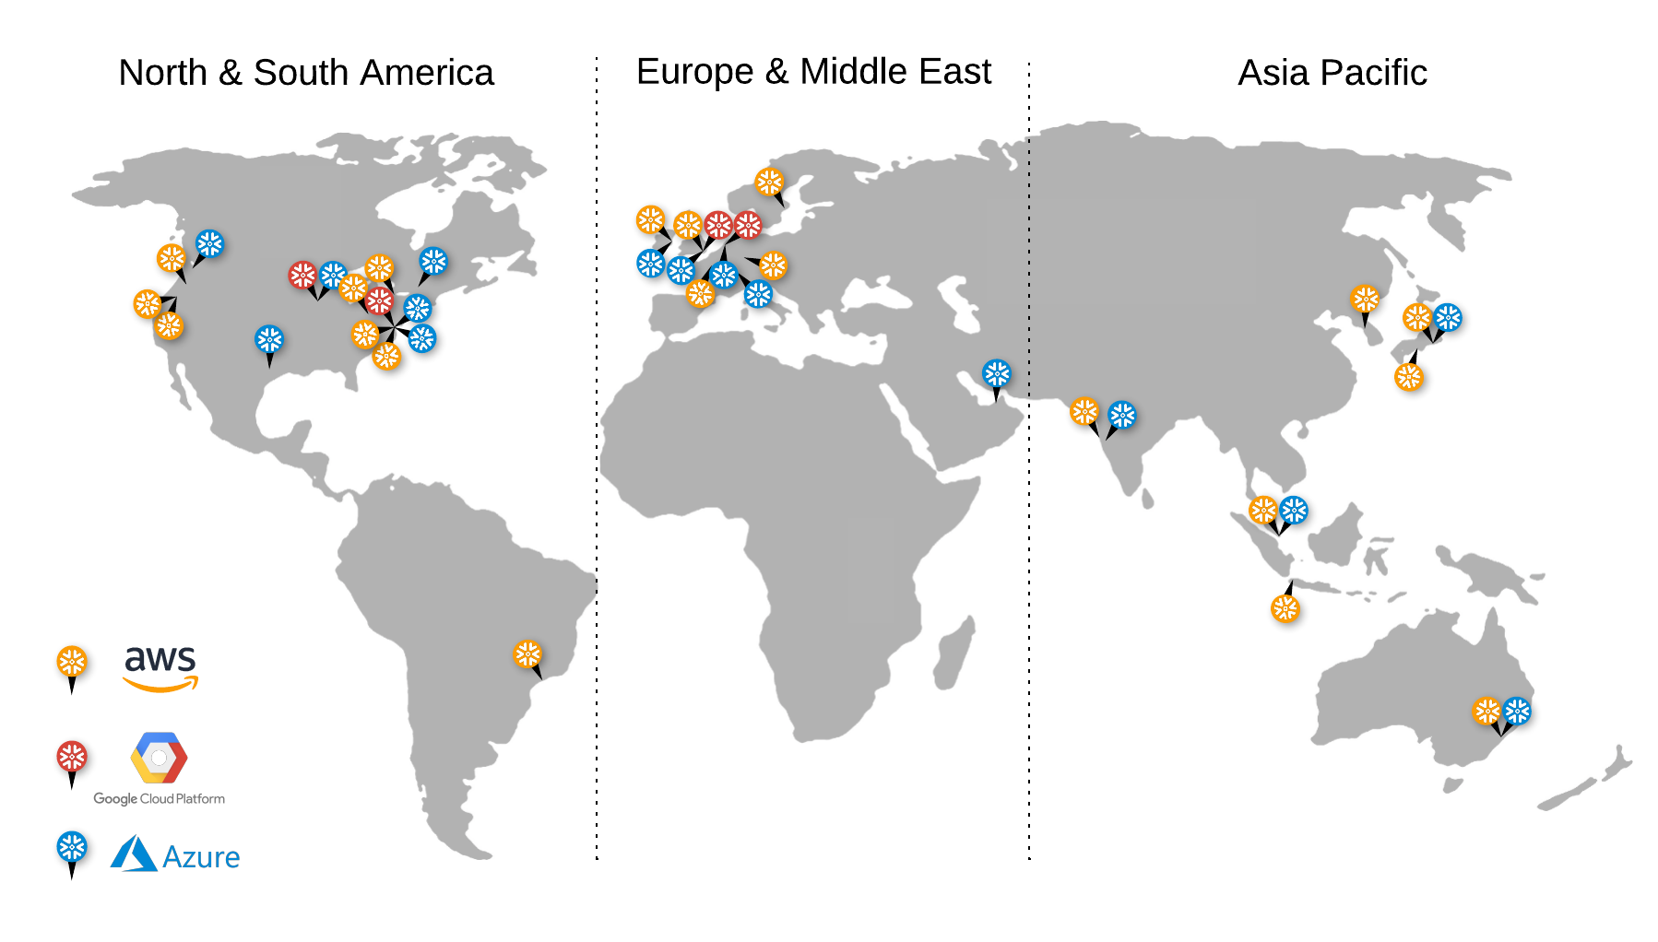
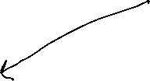
Supported Cloud Regions
Regions let your organization choose where your data is geographically stored across your regional, national, and international operations.
Regions also determine where your storage & compute resources are provisioned.

Slide 6
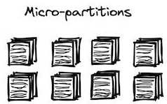
Snowflake Architecture
Built only for the CLOUD
Separates COMPUTE and STORAGE
Storage layer and Cloud services layer infinite scalable
Virtual Warehouse almost infinite scalable
Snowflake – Multi-Cluster Shared Data Architecture
Notes:
Earlier Shared-Disk (Scalable) Architecture and Shared-Nothing (Scalable) Architecture

Slide 7
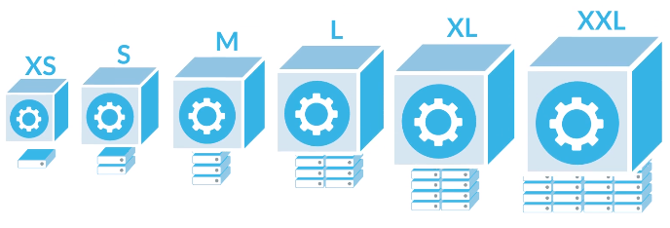
Virtual Warehouse (Compute)
The size of virtual-warehouse determines the number of servers in each cluster in the warehouse, which doubles with next incremental size
Each node (ec2 instance) has 8 vCores/threads, regardless of cloud provider with 16Gb Ram and 200Gb SSD
Default Auto-Suspend : 5 minutes
Virtual warehouse are independent of each i.e. like we can have one for data loading, another used for accessing / analyzing the loaded data.

Slide 8
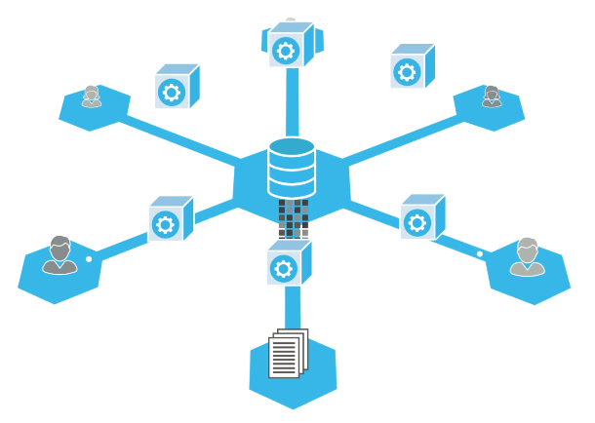
‘2XL’ Virtual Warehouse Data Analyst
‘XL’ Virtual Warehouse Data Scientist
‘M’ Virtual Warehouse ETL

Slide 9
Data Storage
In AWS/S3 Object or AZURE Blob way
Columnar Storage
Compressed
AES 256 encrypted
All above the process is automated while data loading in snowflake

Slide 10
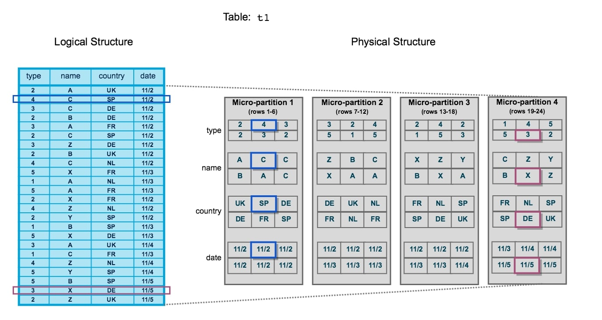
Eg: Observe how the blue coloured and magenta coloured data stored

Slide 11
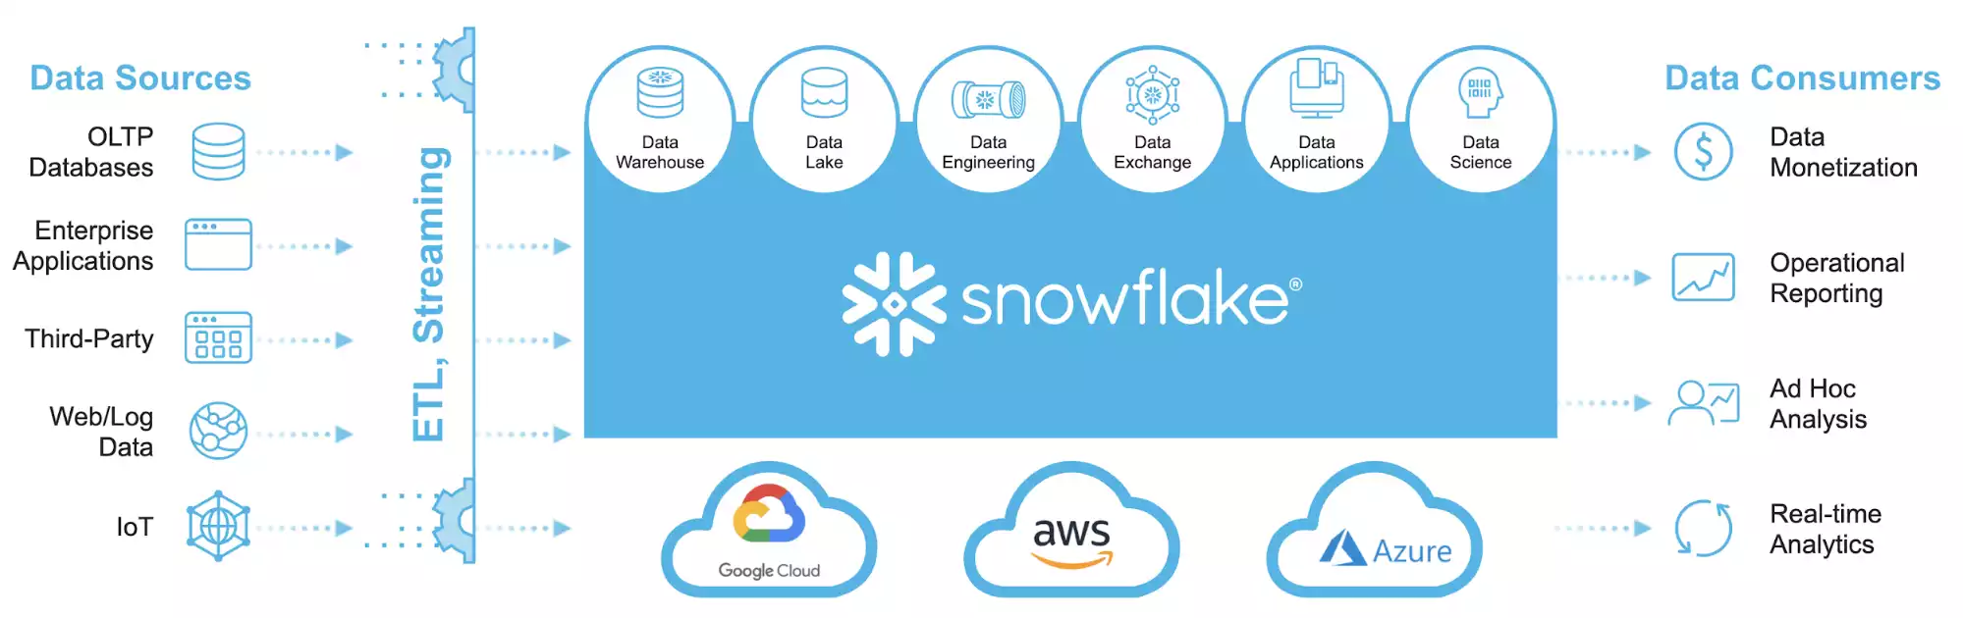
Snowflake

Slide 12
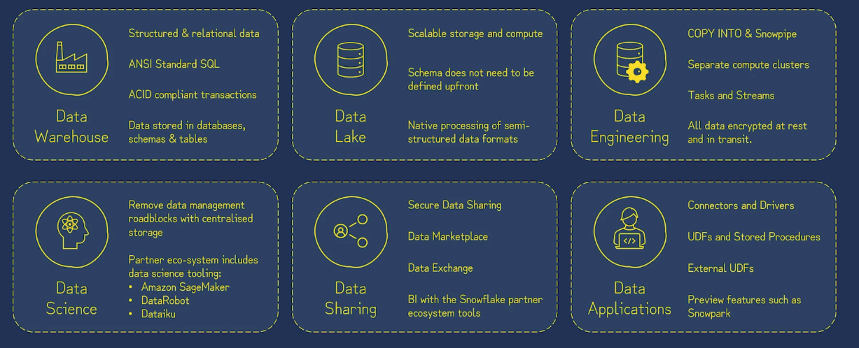

Slide 13
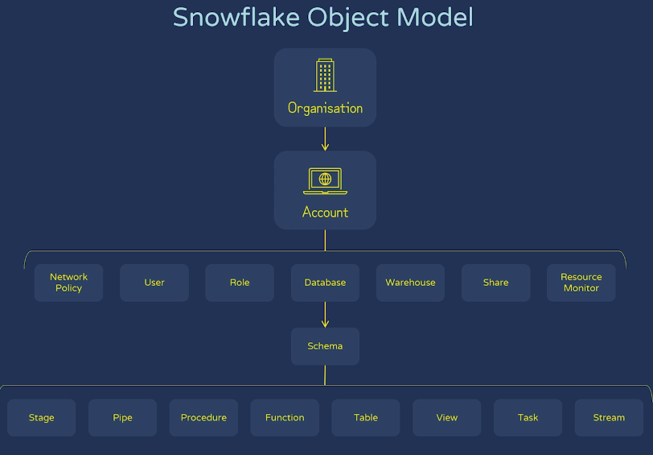
1 to Many Relationships

